Slide 1
Transfer Learning in Computer Vision
Transfer learning is one of the most practical and widely used techniques in modern computer vision — enabling high-performing models without massive datasets or extreme compute budgets.

Slide 2
Contents
01
02
Why Do We Need Transfer Learning?
What is Transfer Learning
03
04
Typical Workflow
Popular Pre-Trained Models
05
06
Comparison of Pre-Trained Models
Key Takeaways

Slide 3
Why Do We Need Transfer Learning?
Training deep learning models from scratch is often impractical in real-world settings. The barriers are both computational and data-driven.
Data Requirements
Compute Cost
Millions of labeled images are needed for stable convergence — a bar most domains simply cannot meet.
Training large CNNs from scratch demands weeks of GPU time and significant infrastructure investment.
Limited Domains
The Gap
Medical imaging, satellite data, and industrial inspection all suffer from scarce labeled datasets.
A clear gap exists between theoretically powerful models and what is realistically deployable.

Slide 4

What Is Transfer Learning?
Transfer learning is the process of reusing knowledge acquired from one problem and applying it to a related problem — instead of starting from zero.
Edges
Textures
Low-level boundaries and gradients
Patterns and surface detail
A model trained on ImageNet has already learned edges, textures, shapes, and object structures. These features generalize broadly across vision tasks.
Shapes
Objects
Mid-level spatial structure
High-level semantic representations

Slide 5
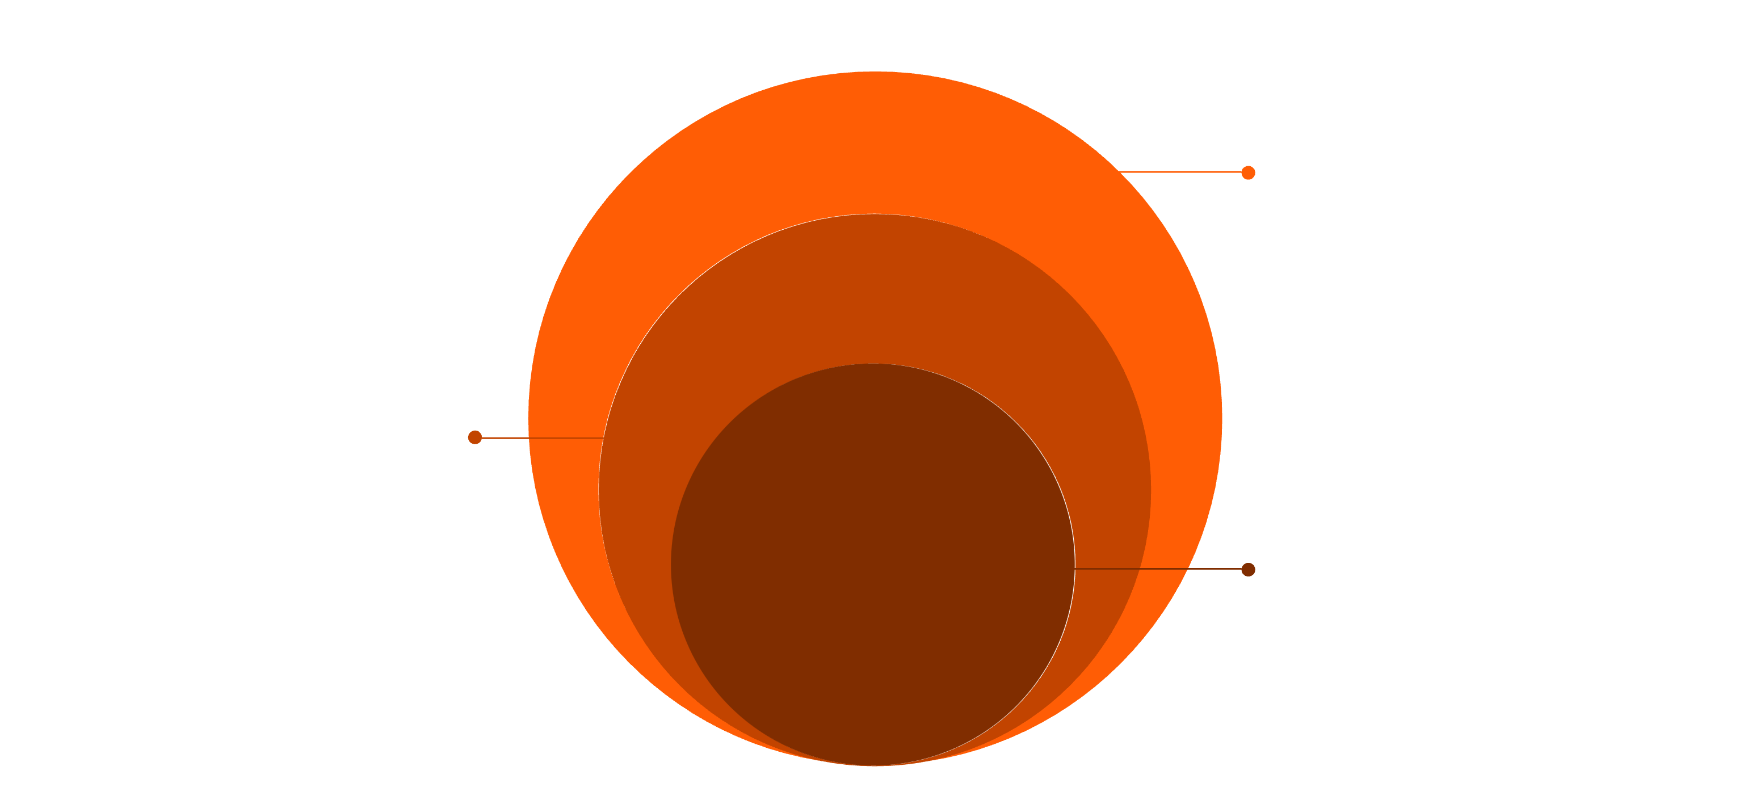
Why It Works: Hierarchical Feature Learning
Deep neural networks learn visual information in a layered hierarchy — from primitive signals to complex semantics.
Early Layers
Capture edges, gradients, and simple patterns
Middle Layers
Represent shapes, textures, and parts
Final Layers
Detect task-specific objects and semantics
Because early and mid-level features are universal across tasks, they can be reused directly — eliminating the need to relearn them on every new dataset.

Slide 6
Visual features are consistent.
That is why transfer learning works so well.
Cross-Domain Consistency
Surprising Generalization
Pre-trained CNNs
Natural images — regardless of subject — share structural similarities at the low level.
Even dissimilar tasks — classifying cats vs. detecting tumors — share foundational low-level patterns.
This makes pre-trained convolutional networks highly reusable across nearly any vision domain.

Slide 7
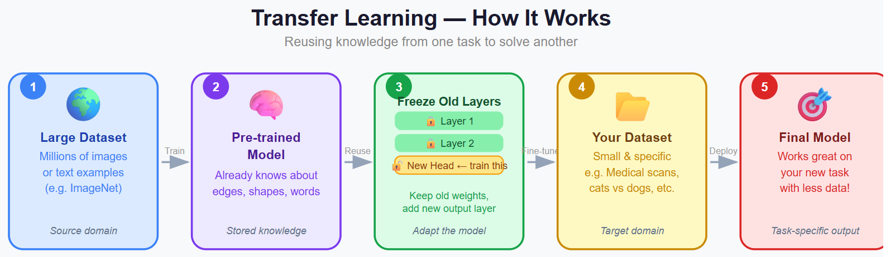

Typical Workflow
Applying transfer learning follows a clear, repeatable pattern regardless of architecture or domain.
Optionally: unfreeze deeper layers and fine-tune with a smaller learning rate for improved performance on sufficient data.

Slide 8
Two Main Strategies
Feature Extraction
Fine-Tuning
Freeze most layers. Use the pre-trained model as a fixed feature generator. Train only the final classification layer.
Unfreeze some top layers. Retrain with a smaller learning rate to allow gradual adaptation to the new domain.
→ Faster. Requires less data.
→ More accurate when data is sufficient.
Rule of thumb: Start with feature extraction. Move to fine-tuning when you have enough labeled data and want higher accuracy.

Slide 9





Benefits of Transfer Learning
Small Data Friendly
Faster Training
Performs well even with limited labeled examples.
Dramatically reduces time to convergence.
Better Generalization
Lower Compute
Pre-trained weights reduce overfitting risk.
Far fewer GPU resources required than training from scratch.
In practice, transfer learning is now the default approach for the vast majority of computer vision problems.

Slide 10
Libraries and Tools
TensorFlow / Keras
Pre-trained Models
Layer Control
High-level API for rapid model building. Provides pre-trained models through tf.keras.applications and simple layer freezing via layer.trainable = False.
Simple freeze/unfreeze APIs for fine-tuning strategies
Ready-to-use weights from ImageNet and other benchmarks
PyTorch
Research-favored framework. Pre-trained models via torchvision.models with flexible fine-tuning control and requires_grad flags.
Built-in Datasets
Standard datasets and data loaders included out of the box

Slide 11



ARCHITECTURE OVERVIEW
Popular Pre-Trained Models
VGG, ResNet, and Inception represent three distinct philosophical approaches to deep CNN design — all pre-trained on ImageNet (1.2M images, 1,000 classes).
VGG
ResNet
Inception
Simplicity through depth
Depth with stability
Multi-scale efficiency

Slide 12

ARCHITECTURE 1
VGG — Simplicity and Depth
"Use small 3×3 filters consistently and stack many layers deep."
Architecture
Depth
VGG (Simonyan & Zisserman, 2014) proved that network depth using small convolutions is the key driver of performance.
Uniform 3×3 convolutions throughout
16–19 weight layers (VGG16, VGG19)
Trade-off: VGG16/19 contain 138M+ parameters — computationally expensive and memory-intensive at inference time.
Strength
Role
Intuitive, easy to understand and implement
Classic baseline and pedagogical reference

Slide 13

ARCHITECTURE 2
ResNet — Learning Residuals
"Instead of learning a full mapping, learn only what needs to change — the residual."
Key Innovation
What It Learns
Skip connections that bypass one or more layers
The residual difference, not the full transformation
He et al. (2015) showed that skip connections allow gradients to flow freely, enabling networks with 50–150+ layers to train stably.
Depth
Solves
ResNet made deep learning truly scalable and remains the most widely used backbone in practice.
ResNet-50, ResNet-101, ResNet-152 and beyond
Vanishing gradient problem in very deep networks

Slide 14
ARCHITECTURE 3
Inception — Multi-Scale Learning
"Why choose one filter size? Apply all of them in parallel and let the network decide."
1×1 Filters
3×3 Filters
GoogLeNet / Inception (Szegedy et al., 2014) introduced the Inception module — a parallel multi-filter block that captures features at multiple spatial scales simultaneously.
Capture fine-grained point-level features
Medium spatial context and local patterns
5×5 Filters
Pooling
Broader spatial relationships and coarse features
Combined in parallel within each module
Result: richer representations with significantly fewer parameters than naive deep stacking.

Slide 15
Architecture Comparison
Dimension
VGG
ResNet
Inception
Core Idea
Uniform depth, small filters
Skip connections, residuals
Parallel multi-scale filters
Depth
16–19 layers
50–152+ layers
22+ layers (modules)
Parameters
138M+ (heavy)
25M–60M (moderate)
~7M (efficient)
Key Problem Solved
Proved depth matters
Vanishing gradients
Compute efficiency
Best For
Teaching, baselines
General purpose tasks
Speed + accuracy balance
Evolution: VGG → deeper → ResNet → smarter → Inception → more efficient

Slide 16



When to Use Which Architecture
Choose VGG when...
Choose ResNet when...
Choose Inception when...
Simplicity and interpretability are the priority — ideal for teaching, understanding, or quick prototyping where parameter count is not a concern.
You need a strong, reliable baseline for most tasks. It is the default choice in industry and academia — robust, well-understood, and broadly supported.
Both efficiency and performance matter — particularly in deployment-constrained environments where inference speed is critical.
In industry, ResNet and its variants (ResNet-50, ResNeXt, Wide ResNet) dominate production deployments.

Slide 17
Key Takeaways
1
Transfer learning is a practical necessity
2
Visual features are inherently reusable
Not just a theoretical concept — it is the default approach for real-world CV systems.
Pre-trained weights on ImageNet generalize broadly because low-level patterns are universal.
3
Strategy depends on your data
4
Architecture choice reflects design philosophy
Use feature extraction for small datasets; fine-tune when you have sufficient labeled examples.
VGG = simplicity. ResNet = depth with stability. Inception = multi-scale intelligence.

